Slide 1
Theories on which to base our tutoring
Dr. Doris Correa
May 5, 2022
School of Languages
Universida de Antioquia

Slide 2
Agenda –different approaches to writing and different classifications
Product, process and genre-based approaches: History of academic writing by Trimbur (1994), Matsuda (2003), and Atkinson’s (2003) –presentation comps
Study skills, academic socialization and academic literacies- History by Lea & Street (1998)- my chart and Archer’s

Slide 3
Archer’s main ideas
Academic discourse takes a distinct written form, comprising often unspoken conventions which dictate appropriate uses of lexico-grammatical structures-(Chart Schleppegrell, 2004).
There are different models for teaching writing and these approaches are not mutually exclusive nor are they linear stages of ‘progression’

Slide 4
Hyland’s main ideas
While this approach (process) responds to the individual needs and personalities of learners, it offers them little by way of the resources to participate in, understand, or challenge valued discourses (e.g., Hasan, 1996; Martin, 1993). It leaves students innocent of the valued ways of acting and being in society, despite the fact that they need ways to manage the appropriate linguistic and rhetorical tools to both gain access to the powerful genres of mainstream culture and the means to conduct a critical appraisal of them.
There are three main schools: ESP, New Rhetoric and Sydney
The Sydney school is based on Halliday’s ideas – SFL chart
Aim: helping learners gain access to ways of communicating that have accrued cultural capital in particular professional, academic, and occupational communities
The curriculum or teaching and learning cycle helps students do that- various Charts

Slide 5
Narrative Stages
The “abstract indicates what the story is about” (Cheng, 2008, p. 171).
The orientation provides a sketch of this particular story, that is, it introduces the readers to the main characters of the narrative, indicates where the action is located and when it is taking place, establishes the atmosphere, foreshadows the action to follow, and makes the reader want to become involved in the story (Derewianka, 2004).
The complication introduces a series of events during which there is “one or more problems for characters to resolve, involving problem and struggle episodes.
Evaluation highlights the significance of events for characters and resolution to resolve these issues.
Coda brings readers back to the present situation” (Cheng, 2008, p. 172).

Slide 6
Features of Narratives
Participants are often “specific and individualized characters” (Cheng, 2008, p. 172), with “defined identities” (Derewianka, 2004, p. 42).
To characterize and describe these participants, writers frequently use pre- and post-modifying elements, including adjectives, adverbs, -ed/-ing participles, prepositional phrases, and relative clauses (Fang, Schleppegrell, & Cox, 2006).
Processes are mainly material (action verbs), relational, verbal, and mental. They help writers further identify and characterize the participants while simultaneously allowing them to construct action sequences and paint an image of what the characters said, felt, and thought (Derewianka, 2004).
Circumstances are realized through adverbs which “build up the material reality of the possible world” (Cheng, 2008, p. 172), “introduce information about manner, and express judgment about behavior” (Schleppegrell, 2004, p. 85).

Slide 7
Features of Narratives
Mood resources such as exclamatives, rhetorical questions, and quoted speech to create suspense (Cheng, 2008).
Imperatives and one-word sentences to construct more “poignant effects” on the readers (Knapp & Watkins, 2005, p. 222).
Appraisal devices to move through the evaluative and reflective stages of their narratives, to enhance their meanings, and “to create images in the readers’
Theme progression to mark that events are happening in a time sequence.
Textual themes or conjunctive devices of time and sequence (after, as, before, since, till, until, when, while), contrast (although, even though, though, whereas, while, rather than), consequence (in consequence, as a consequence, as a result, therefore, hence, for this reason, that is why, and thus), to signpost the unfolding of events, signal the crisis point of the story, or indicate a return to normality.
Interpersonal themes (e.g., unfortunately, surprisingly) to indicate the way the writer is evaluating the events of the complication.
Marked circumstances as topical themes to set the story in a time and place (Butt et al., 2006).ds” (Derewianka, 2004, p. 44).

Slide 8
Cognitivist Views (Chomsky 1959, Anderson 1977, Chamot & O’Malley1989) | Sociocultural view (Vygotsky 1962) Halliday 1977 | Critical view (Marxist and neomarxist theory, Gramsci, Bordieu) Freire 1970 | Poststructural view (Foucault , Derrida Bakhtin, Hall, Judith Butler )
Texts as collections of sentences and vocabulary words following certain patterns | Texts as situated and varying according to context, situation, purpose and audience | Texts tools for emancipation, as vehicles for self expression , as revealers of the truth and as having only one interpretation | Texts as intertextual, multivocal, with multiple contradictions, readings and interpretations
To be able to decode writing | To be able to identify culturally appropriate forms of discourse | To understand how texts reproduces social inequalities as they relate to issues such as race , gender , social class, etc | Being able to see conflicting and competing discourses, voices, psitionings and repositioning
An individual internal capability | A contextual and social practice (one has to be socialized into a practice to learn to read texts of type X in way Y) | An emancipatory practice that allows us to see inequalities expressed, produced and reproduced through language | A complex practice that involves finding multiple views of what is happening, not the truth about what is happening
A culturally neutral activity, universal in its features | A culturally specific activity | A culturally specific activity embedded with issues of power, domination, access, diversity, etc | A historically charged activity that involves understanding how texts constitute power relations, how texts position, locate, define, and enable and regulate readers, and how texts construct social identities, and make available various meanings, ideas and versions of the world
A fixed set of skills | A plural set of social practices into which sts are acculturated | A reflective and critical practice that involves naming and renaming of the world and developing the capacity to rewrite, redesign and reshape it in community’s interests | The practice of complexifying and deconstructing ideas about gender, class, race, ethnicity, etc.

Slide 9
C-Discourse communities
Discourse communities: it has not been easy to agree on exactly what the term means.
We need to avoid framing discourse communities as determinate, static, autonomous, and predictable arenas of shared and agreed upon values and conventions, steering clear of the idea of ‘‘discursive utopias’’
Recently they are seen not as monolithic and unitary structures but as systems of multiply overlapping and intersecting beliefs and practices

Slide 10
History | Sciences
Relations of cause-effect, temporatility or causality Relations of being and having Interaction of past and present Actions become things People are effaced Participants run from personal to abstract with lots of participants being institutions, things or places Nonhuman actors (the north) Events presented as just happening with non-identified agents Attitude and judgement presented implicitely Conjunctions and temporal adjuntcs in first position | Abstract, objective stance Information oriented Use of passive voice and technical terms Material and relational processes Grammatical metaphors Expanded nominal groups

Slide 11
History | Sciences
Participants: Nonhuman actors institutions, things, places or non-identified agents (the north), Processes: of being and having, nominalizations Circumstances : temporatility or causality Tense: Interaction of past and present Voice: active Stance: Attitude and judgement presented implicitely (developed, growth, rose, a large amount, doubled) Connectors: Conjunctive links (so, because, although, despite, when ) and temporal adjuntcs in first position (between 1914 and 1926, during the 1920s…) | Participants: technical terms (pollen, pistil), Grammatical metaphors (pollination), expanded nominal groups (parts that work together to make sedes, pollen, a kind of powder) Processes: Material and relational (make, form, is) Circumstances: seem to be temporal but are really???(pollination happens when pollen is carried from a stamen to a pistil) Tense: present Voice: passive or combination of active and passive voice (the pollen is transferred) Stance: abstract, objective avoiding expressions of attitude and juedgement Connectors: almost none (for example)

Slide 12
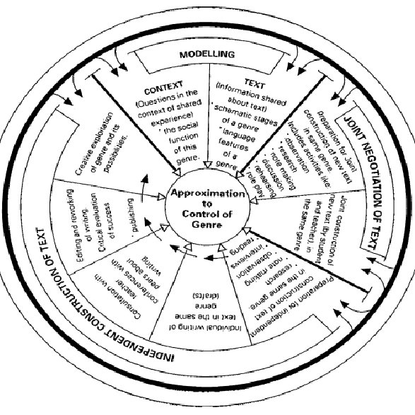
The Teaching & Learning Cycle
(Callaghan & Rothery, 1988, Callaghan & Knapp, 1989, Macken et al, 1989)

Slide 13
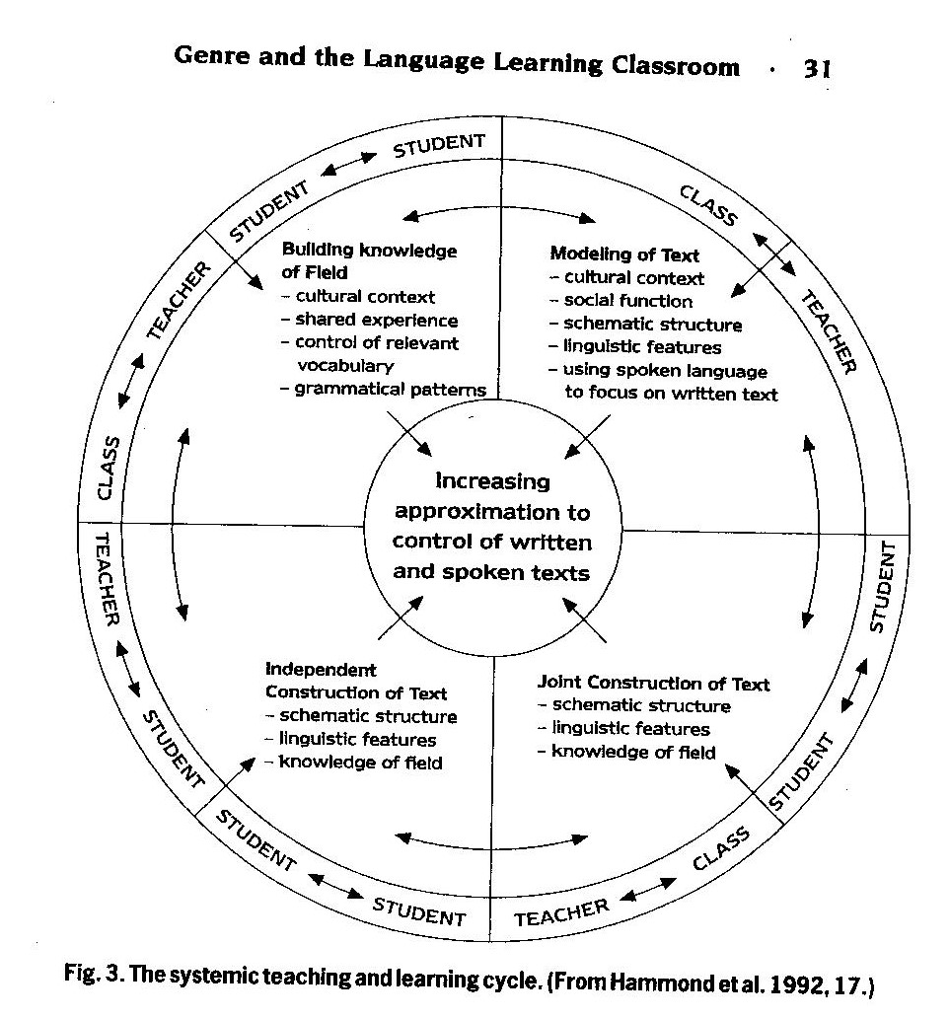
The teaching-learning cycle- Derewianka, 2004, Gebhard & Harman, 2011, Butt et al., 2000, Hyland, 2003, Hammond et al., 1992).
(
Notes:
Read from article what we did in each stage
Evaluator wonders why i did not use the original authors of the cycle (critsite, martin, rose and rothery) and cited other people instead.
According to my research, the original authors were callghan and rothery 88, then martin 89, macken et al. 89, derewianka 90 (in knapp & watkins model) and 91, (in Christie1999) and martin and rothery 91. my original work drew from derewaianka who was one original author but the evaluators were not fine with me citing only one autor for this part, so i looked for other refs that described the cylce in pretty much the same terms deerewianka had.

Slide 14
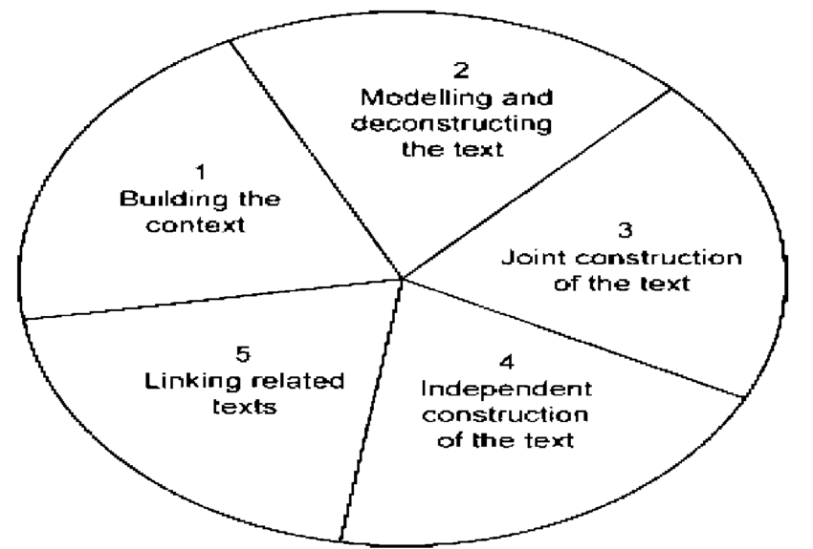
The teaching & learning cycle-Feez, 1998

Slide 15
names
Author | Name
Derewianka (2004) | The Curriculum Cycle
Feez (2002) | The Genre-based Cycle
Callaghan, Knapp & Noble’s (1993) | The Martin/Rothery Curriculum Cycle
Macken et al. (1989) | The Martin/DSP Wheel Model of Genre Literacy Pedagogy
Martin’s (1989) | Wheel Model of Genre Literacy Pedagogy,
Callaghan & Rothery (1988), Hyon 1996 | The Teaching and Learning Cycle

Slide 16
SFL | ESP
SFL is based on functional linguistics (Halliday, 1994) and sociocultural theories of learning (Vygotsky, 1978). | ESP draws from more eclectic theoretical foundations
In SFL , genres tend to be characterized as broad rhetorical patterns such as narratives, recounts, arguments, and expositions. These are sometimes referred to as elemental genres which combine to form more complex everyday macro genres | In ESP, genres are seen as the purposive actions routinely used by community members to achieve a particular purpose. Genres are therefore the property of the communities that use them rather than the wider culture
SFL tends to emphasize language rather more in this process, drawing on functional grammar to do so | ESP stresses the importance of the situatedness of genres in particular contexts through rhetorical consciousness raising
Classes are usually planned around themes, as in many SFL | Classes are usually planned around the genres likely to be encountered in a relevant context
Uses ‘‘writing frames’’ which are simply skeletal outlines used to scaffold and prompt students’ writing. | Uses the structure elaborated by Halliday’s followers
Both approaches seek to reveal the rhetorical patterning of a genre together with its key features
Both recognise that the ability to see texts as similar or different, and to write or respond to them appropriately, is vital to achieving literacy in a second language.

Slide 17
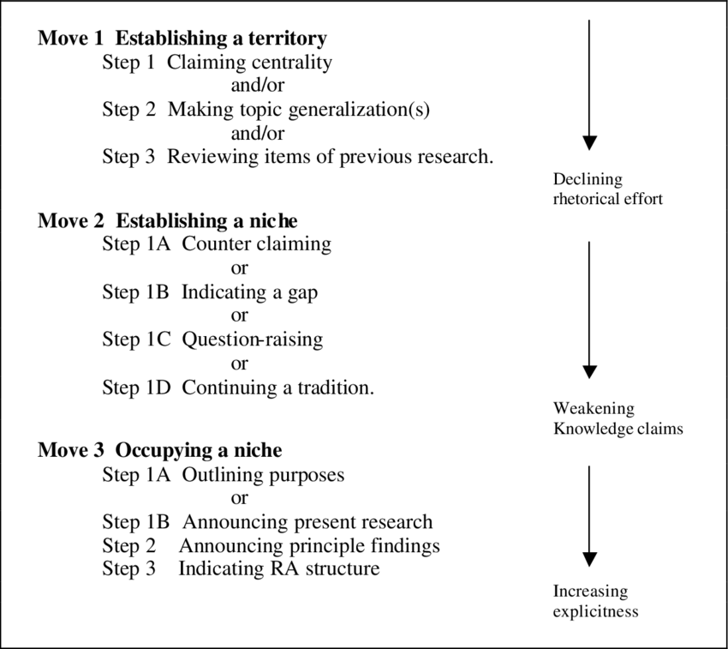
The Creating a Research Space [C.A.R.S.]: the organizational pattern of writing the introduction to scholarly research studies in a variety of disciplines:
https://libguides.usc.edu/writingguide/CARS

